Slide 1
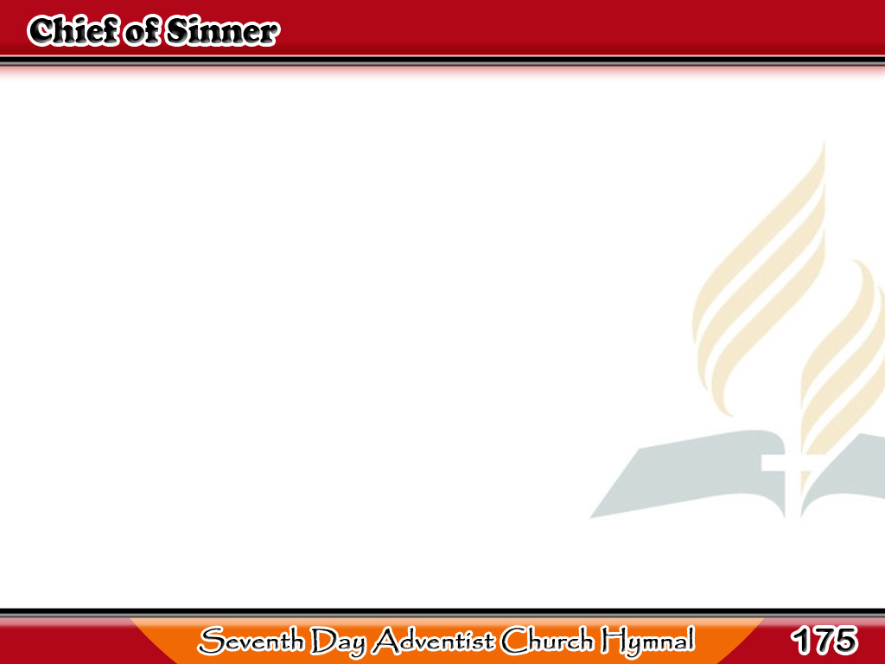
Akong Makasalanan
Chief of sinners though I be,
Jesus shed His blood for me;
Died that I might live on high,
1/3

Slide 2
Akong Makasalanan
Died that I might never die;
As the branch is to the vine,
I am His, and He is mine.
1/3

Slide 3
Akong Makasalanan
O the height of Jesus’ love!
Higher than the heaven above,
Deeper than the deepest sea,
2/3

Slide 4
Akong Makasalanan
Lasting as eternity;
Love that found me
wondrous thought!
Found me when I sought Him not!
2/3

Slide 5
Akong Makasalanan
Chief of sinners though I be,
Christ is all in all to me;
All my wants to Him are known,
3/3

Slide 6
Akong Makasalanan
All my sorrows are His own;
Safe with Him from earthly strife,
He sustains the hidden life.
3/3

